Slide 1
Cryptography
characterize cryptographic system by:
  type of encryption operations used
    substitution / transposition / product
  number of keys used
    single-key or private / two-key or public
  way in which plaintext is processed
    block / stream
Notes:
Cryptographic systems can be characterized along these three independent dimensions.

Slide 2
Cryptanalysis
objective to recover key not just message
general approaches:
  cryptanalytic attack
  brute-force attack
Notes:
Typically objective is to recover the key in use rather then simply to recover the plaintext of a single ciphertext.
There are two general approaches:
Cryptanalytic attacks rely on the nature of the algorithm plus perhaps some knowledge of the general characteristics of the plaintext or even some sample plaintext-ciphertext pairs.
Brute-force attacks try every possible key on a piece of ciphertext until an intelligible translation into plaintext is obtained. On average,half of all possible keys must be tried to achieve success.

Slide 3
Typically objective is to recover the key in use rather then simply to recover the plaintext of a single ciphertext.
There are two general approaches:
Cryptanalytic attacks rely on the nature of the algorithm plus perhaps some knowledge of the general characteristics of the plaintext or even some sample plaintext-ciphertext pairs.
Brute-force attacks try every possible key on a piece of ciphertext until an intelligible translation into plaintext is obtained. On average,half of all possible keys must be tried to achieve success.

Slide 4
Cryptanalytic Attacks
ciphertext only
  only know algorithm & ciphertext, is statistical, know or can identify plaintext
known plaintext
  know/suspect plaintext & ciphertext
chosen plaintext
  select plaintext and obtain ciphertext
chosen ciphertext
  select ciphertext and obtain plaintext
chosen text
  select plaintext or ciphertext to en/decrypt
Notes:
Stallings Table 2.1 summarizes the various types of cryptanalytic attacks, based on the amount of information known to the cryptanalyst, from least to most. The most difficult problem is presented when all that is available is the ciphertext only. In some cases, not even the encryption algorithm is known, but in general we can assume that the opponent does know the algorithm used for encryption. Then with increasing information have the other attacks. Generally, an encryption algorithm is designed to withstand a known-plaintext attack.

Slide 5
Stallings Table 2.1 summarizes the various types of cryptanalytic attacks, based on the amount of information known to the cryptanalyst, from least to most. The most difficult problem is presented when all that is available is the ciphertext only. In some cases, not even the encryption algorithm is known, but in general we can assume that the opponent does know the algorithm used for encryption. Then with increasing information have the other attacks. Generally, an encryption algorithm is designed to withstand a known-plaintext attack.

Slide 6
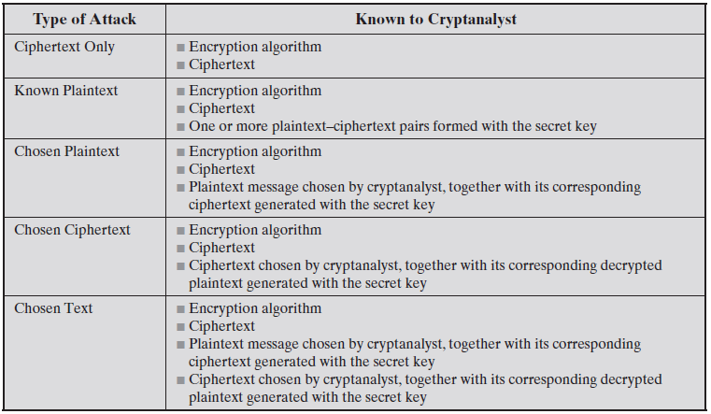

Slide 7
More Definitions
unconditional security
  no matter how much computer power or time is available, the cipher cannot be broken since the ciphertext provides insufficient information to uniquely determine the corresponding plaintext
computational security
  given limited computing resources (eg time needed for calculations is greater than age of universe), the cipher cannot be broken
Notes:
Two more definitions are worthy of note. An encryption scheme is unconditionally secure if the ciphertext generated by the scheme does not contain enough information to determine uniquely the corresponding plaintext, no matter how much ciphertext is available. An encryption scheme is said to be computationally secure if either the cost of breaking the cipher exceeds the value of the encrypted information, or the time required to break the cipher exceeds the useful lifetime of the information. Unconditional security would be nice, but the only known such cipher is the one-time pad (later).
For all reasonable encryption algorithms, we have to assume computational security where it either takes too long, or is too expensive, to bother breaking the cipher.

Slide 8
Two more definitions are worthy of note. An encryption scheme is unconditionally secure if the ciphertext generated by the scheme does not contain enough information to determine uniquely the corresponding plaintext, no matter how much ciphertext is available. An encryption scheme is said to be computationally secure if either the cost of breaking the cipher exceeds the value of the encrypted information, or the time required to break the cipher exceeds the useful lifetime of the information. Unconditional security would be nice, but the only known such cipher is the one-time pad (later).
For all reasonable encryption algorithms, we have to assume computational security where it either takes too long, or is too expensive, to bother breaking the cipher.

Slide 9
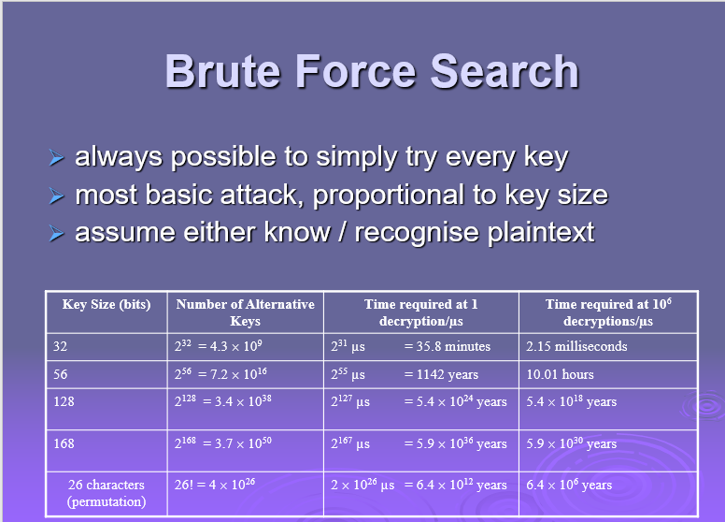

Slide 10
A brute-force attack involves trying every possible key until an intelligible translation of the ciphertext into plaintext is obtained. On average, half of all possible keys must be tried to achieve success. Stallings Table 2.2 shows how much time is required to conduct a brute-force attack, for various common key sizes (DES is 56, AES is 128, Triple-DES is 168, plus general mono-alphabetic cipher), where either a single system or a million parallel systems, are used.

